Slide 1
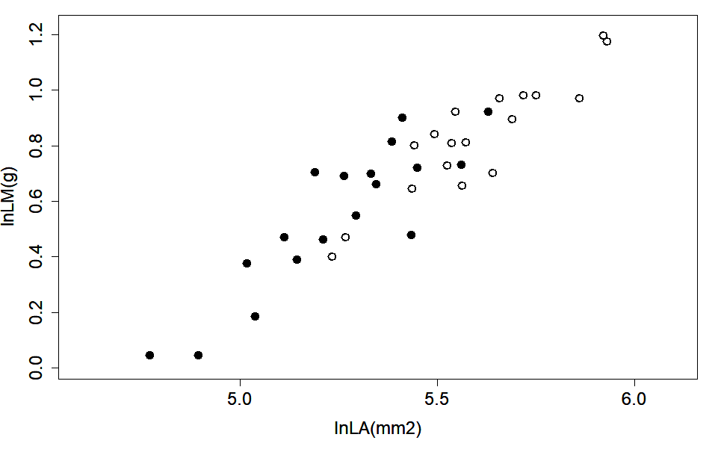


Group A
y=1.0757x-5.1919
R ²=0.8276, P<0.01
Group B
y=1.1673x-5.5796
R ²=0.7797, P<0.01

Slide 2
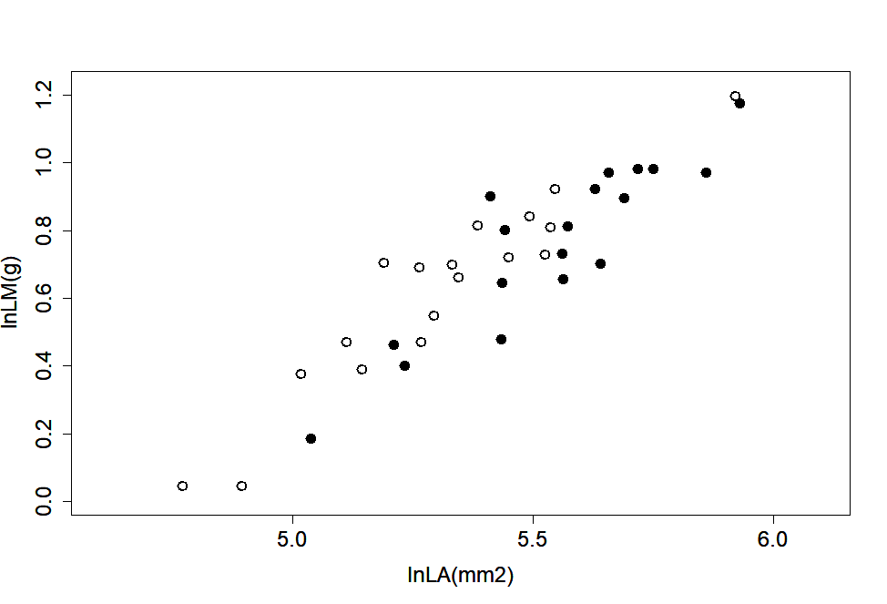
Group C
y=1.0729x-5.0725
R ²=0.8979, P<0.01
Group D
y=1.1006x-5.3408
R ²=0.8125, P<0.01

Slide 3
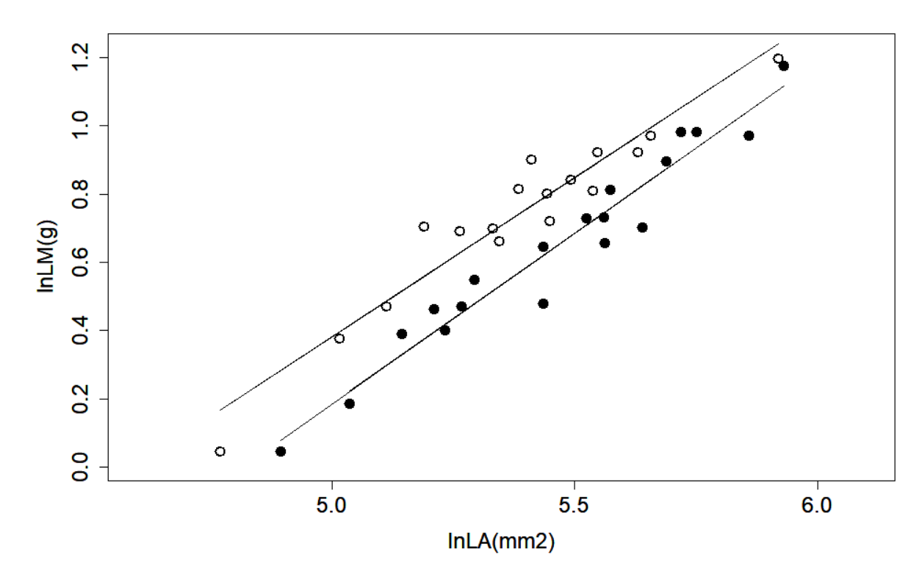
Group E
y=0.9727x--4.9656
R ²=0.9214, P<0.01
Group F
y=1.0275x-5.5796
R ²=0.9466, P<0.01

Slide 4
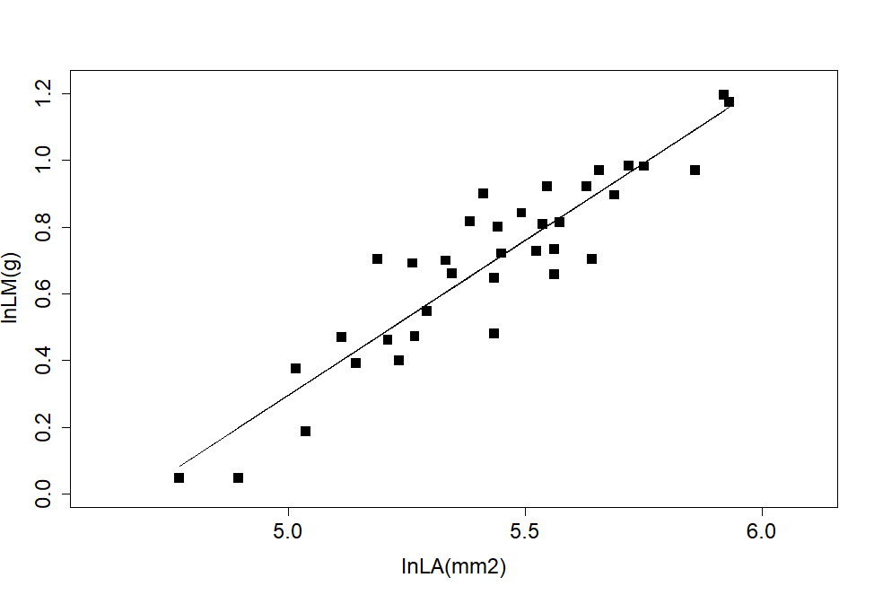
y=1.0074x-4.7749
R ²=0.8434, P<0.01

